Slide 1
Evaluating mHealth technology in HIV to improve Empowerment and healthcare utilisation: Research and innovation to Generate Evidence for personalised care https://www.emergeproject.eu/ May 2015 - April 2020
EmERGE Project has received funding from the European Union's Horizon 2020.
Research and Innovation Programme under Grant Agreement No:643736

Slide 2
Project partners
Project leader:
Brighton and Sussex University Hospitals NHS Trust (UK)
Project partners:
UNIVERSITY OF SUSSEX – United Kingdom
EUROPEAN AIDS TREATMENT GROUP - Germany
UNIVERSITY OF BRIGHTON – United Kingdom
PRINS LEOPOLD INSTITUUT VOOR TROPISCHE GENEESKUNDE - Belgium
FUNDACIO PRIVADA CLINIC PER A LA RECERCA BIOMEDICA - Spain
CENTRO HOSPITALAR DE LISBOA CENTRAL, EPE - Portugal
KLINIKA ZA INFEKTIVNE BOLESTI DR. FRAN MIHALJEVIC - Croatia
NPMS-HHC CIC - United Kingdom
UNIVERSIDAD POLITECNICA DE MADRID - Spain
EmERGE MHEALTH LTD - United Kingdom
MODUS RESEARCH AND INNOVATION - United Kingdom
Emerge Project General Presentation

Slide 3
Background and Rationale
Due to effective antiretroviral therapy (ART), HIV now regarded as a chronic illness with a normal life expectancy in individuals who have access to testing, treatment and care. The vast majority of individuals have undetectable HIV viral loads on stable treatment and now seek to reduce the impact of HIV on their lives.
Individuals living with HIV are currently seen by an HIV clinician every 3-6 months according to national and international guidelines. Given that the number of new diagnoses and onward transmissions are at best stable, if not increasing, in association with longevity, the number of patients requiring treatment and care continues to increase year on year.
Therefore it is imperative that new models of service provision are explored and evaluated.
Emerge Project General Presentation

Slide 4
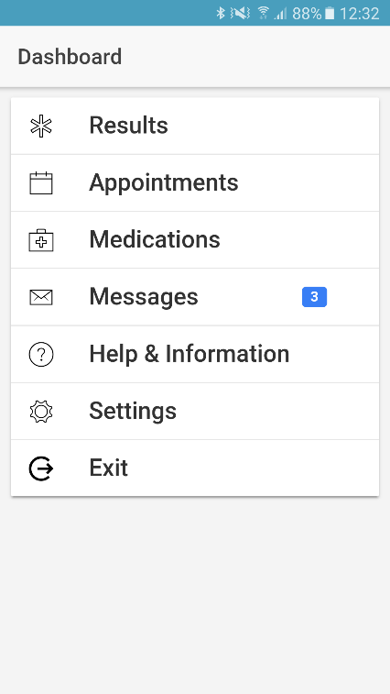
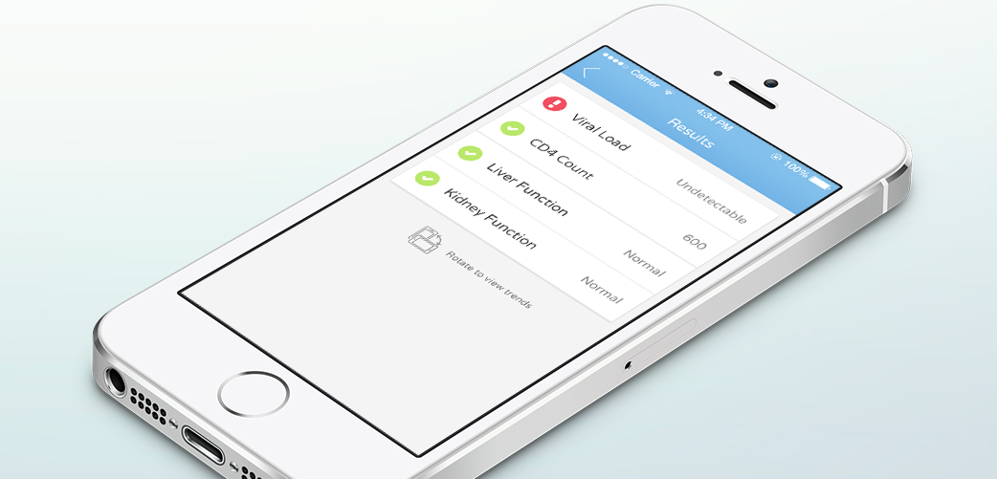
mHealth Platform
mHealth solutions offer an opportunity to provide alternatives to traditional care that can reduce appointments for stable patients and increase capacity to those living with more complex disease.
Emerge Project General Presentation

Slide 5
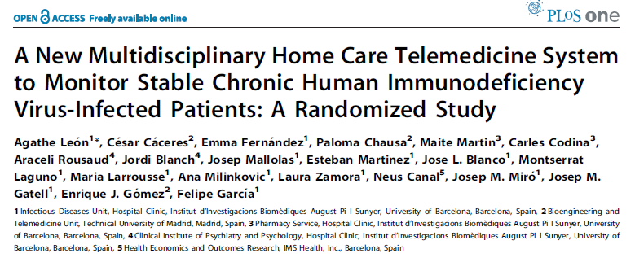
From ‘idea to application’
Brighton – email service since 2008
Barcelona – Virtual Hospital since 2005
Review 2013: 25% (n=532) of cohort using Connect
97% of 212 survey respondents would recommend to a friend
Emerge Project General Presentation

Slide 6
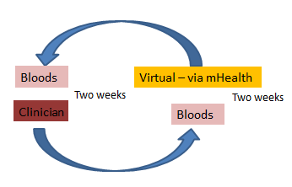
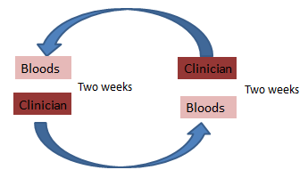
EmERGE Concept
EmERGE pathway – seen routinely once a year with interim visit carried out via mHealth platform
*Results checked by a clinician
*Pushed through securely to ‘App’ with medication info & future appt
* Prescription issued
* Option to pause if any problems
Person living with stable HIV seen twice a year for routine follow-up, usually with blood samples drawn two weeks prior to clinician appointment
Emerge Project General Presentation

Slide 7
EmERGE Project Goal
To assess the impact of a co-designed mHealth platform for people living with medically stable HIV in diverse care settings across five European countries.
Emerge Project General Presentation

Slide 8
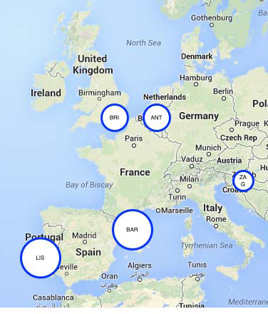
Background Assessment
Background Assessment & situational analysis, questionnaire & visits to five sites
Information governance &
ethico-legal requirements
ICT & Data security
HIV care organisation
... ensuring GDPR compliant / DPA
Ludwig Apers; Steven Hoornaert ITM
Emerge Project General Presentation

Slide 9
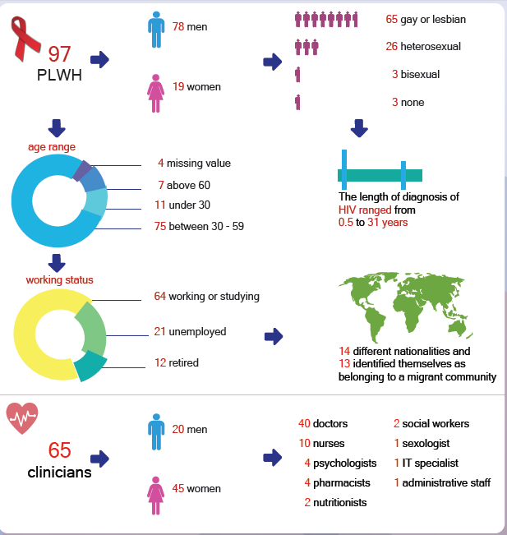
Co-design & Socio-technical evaluation
Phase 1: Pre-implementation focus groups & interviews;
Community (97) & HCPs (65 participants)
Issues & needs highlighted -
addressed in the design of app;
features; access to data; perceptions;
security
Phase 2: Evaluation use of app in action
- ‘wider lens’ work underway
Flis Henwood; Mary Darking; Ben Marent UOB
Koen Block; Brian West EATG
Emerge Project General Presentation

Slide 10
Co-design & Socio-technical evaluation
Approaching the app
Patients’ considerations Re-negotiating stigma? New opportunities for control? |  | Clinicians’ considerations Keeping up with technological advances? Re-negotiating the patient role?
Imagining the app
Medical functionalities Accessing blood results Managing medicines Managing appointments Digital communication channels | Social functionalities Peer support network International travel Changing public attitudes towards HIV (social activities) |  | General features Security and privacy Credibility Sustainability Language (simple and local language) Sensitivity for Disabilities No costs Training/ tutorials Other technicalities
Anticipating the app’s implications
Tensions towards the patient Reassurance vs. uncertainty Closeness vs. distance Self-knowledge vs. reductionist understanding |  | Questions for HC providers Complementing or replacing traditional clinical pathways? Improving quality or downsizing healthcare expenditure? Increasing or decreasing workload?
Emerge Project General Presentation

Slide 11
Co-design & Socio-technical evaluation
Medical functionalities:
Access to blood results
Managing medicines
Managing appointments
Digital communication channels
‘If I could receive my medical information … the results of my blood tests through the app, I wouldn't have to go to the internist … the app could save me a whole lot of health expenses’ [P_An_FG]
‘I have missed a lot of appointments. I think it would be useful to have some reminders to tell me’ [P_Li_FG]
Some PLWH emphasised that they would appreciate a ‘newsfeed’ [P_Ba_WS, male] that notifies ‘if something new comes out in the world of HIV inventions’ [P_An_WS, female]
‘…it happened to me in the hospital … [they] give me medication that interfered with my retroviral [drugs]. And so I think that this application, there should be something that we ourselves could manage this situation ... An application where we could see if we can take the drugs A, B or C with this cocktail of antiretroviral drugs’ [P_Li_FG]
Emerge Project General Presentation

Slide 12
Co-design & Socio-technical evaluation
Access to blood test results imagined and anticipated as being an important function by both patients and clinicians.
Both appointment management systems and medication management systems have been stressed as important functionalities for self-managing HIV.
Ongoing consultation taking on board community wishes as the app evolves.
Emerge Project General Presentation

Slide 13
Platform development & integration
CORE FUNCTIONS
RESULTS
MEDICATION
APPOINTMENTS
Enrique Gomez, Paloma Chausa, UPM (and PODMEDICS 2015-2018)
Emerge Project General Presentation

Slide 14
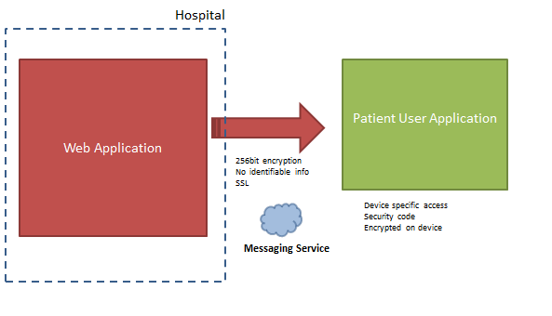
Platform development & integration
Emerge Project General Presentation

Slide 15
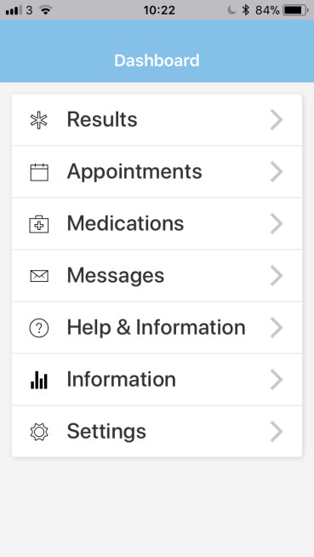
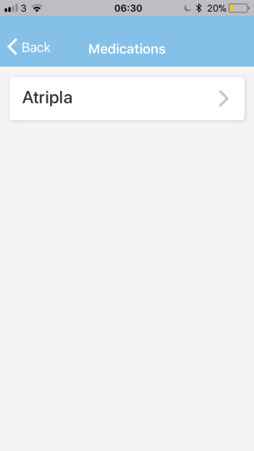
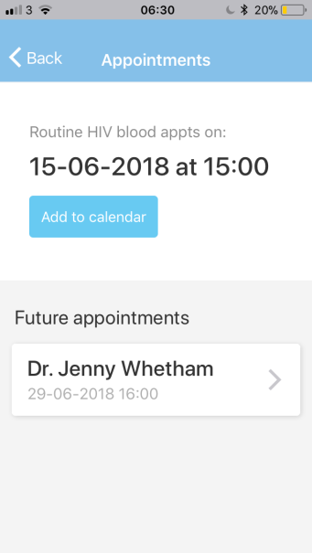
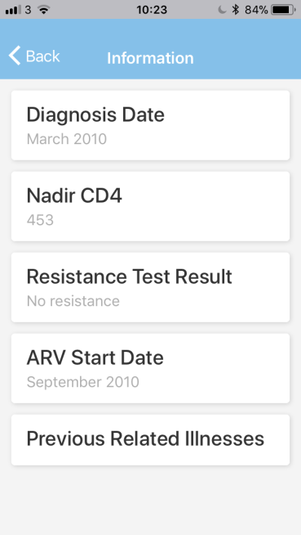
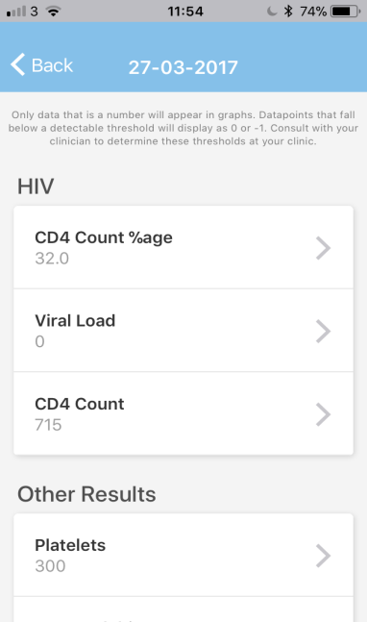
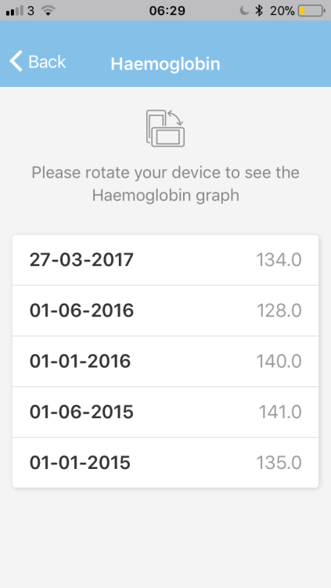
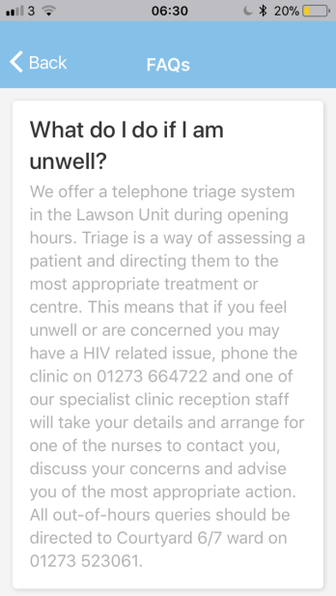
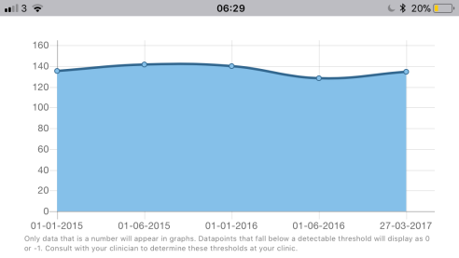
Platform development & integration
FAQs co-written with community groups at sites
Emerge Project General Presentation

Slide 16
Evaluation
Started April 2017 – 2251 participants
Enrolment completed October 2018 (follow-up until Oct19)
Primary objective:
To assess the impact of the mHealth platform on patient self-management and empowerment as determined by the Patient Activation Measure (PAM-13) at month 12
Questionnaires at baseline & annually
Feasibility & uptake / use
Patient experience
Potential effectiveness
Maintenance of quality of care
Cost minimisation
Patient activation (PAM-13)
Quality of Life (EQ5D5L; PROQOL-HIV)
Adherence (M-MASRI)
Patient experience (PREM)
System usability (SUS)
HIV specific PROM [Positive Outcomes]
Successful ageing (FRAIL)
Emerge Project General Presentation

Slide 17
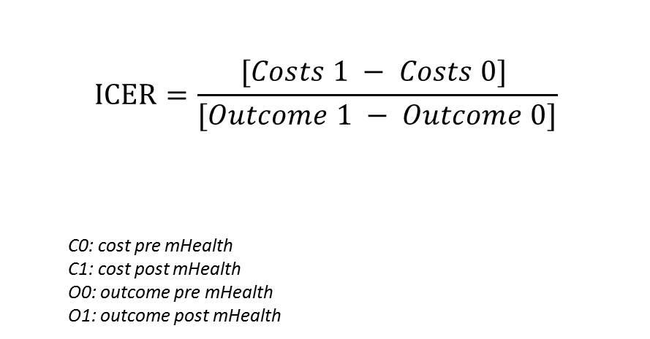
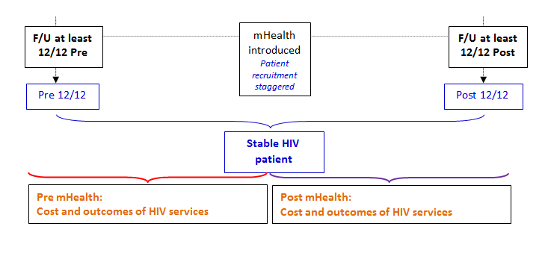
Health economics analysis
Costing studies at each site
Before & after comparison
Costs and outcomes
Cost-effectiveness
EJ Beck, S Mandalia, P Yfantopoulos NPMS-HHC CIC
Emerge Project General Presentation

Slide 18
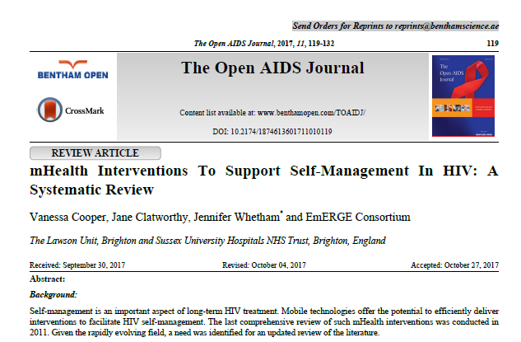
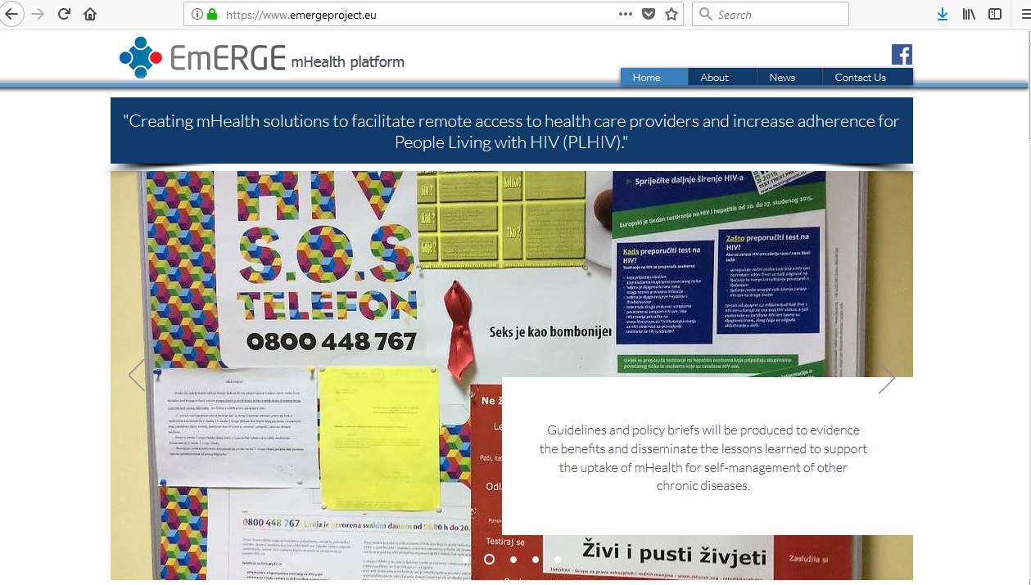
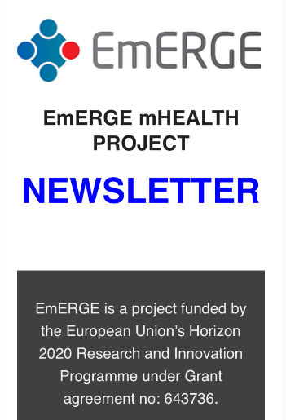
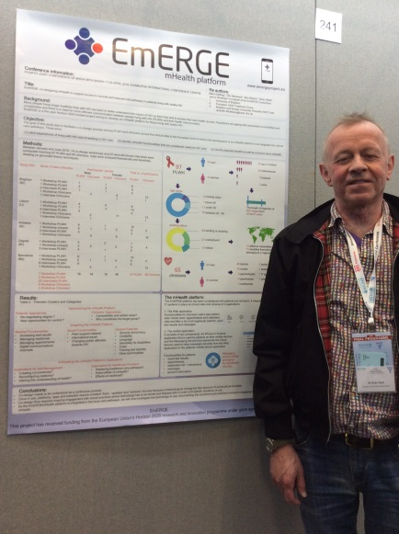
Dissemination
Koen Block, Brian West, Tamás Bereczky,
Deniz Uyanik, Maria Dutarte, Paul Thorn EATG
Emerge Project General Presentation

Slide 19
Key achievements so far
Platform integrated with hospital systems at all five sites;
Live with encrypted data being pushed through to individuals
Robust co-design process which has fed into platform development; high level of community involvement
Completed enrolment at all five sites >2,200 individuals
Dissemination – newsletters; website; FB; conferences; publications
Protocol in place; data collection underway; eCRF developed
Background assessment instrumental; ensuring GDPR compliance
‘Wider lens work’
Costing exercises underway at sites
Strategy for sustainability / not for profit Planning for provision beyond the project
Emerge Project General Presentation

Slide 20
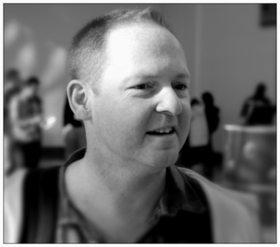
Acknowledgements
The EmERGE consortium
Community groups and participants at each site:
Zagreb
Antwerp
Barcelona
Lisbon
Brighton
Martin Fisher
1964 - 2015
EmERGE Advisory board: Richard Harding; Agathe Leon, Cesar Caceres; Alec Miners
Emerge Project General Presentation

